Slide 1
Chapter 7 Sampling and Sampling Distributions

Slide 2
Populations and Samples
Population
A group that includes all the cases in which the researcher is interested
Individuals, objects, or groups
Sample
A subset of cases from a population

Slide 3
Sampling
Sampling
The process of selecting a subset of cases (a sample)
Basis for inferential statistics, where we make inferences/predictions/generalizations about the population from our sample

Slide 4
Sampling
Parameter
A measure (for example, mean, or standard deviation) used to describe a population distribution
Statistic
A measure (for example, mean, or standard deviation) used to describe a sample distribution

Slide 5
Notation
Table 7.1 Sample and Population Notations

Slide 6
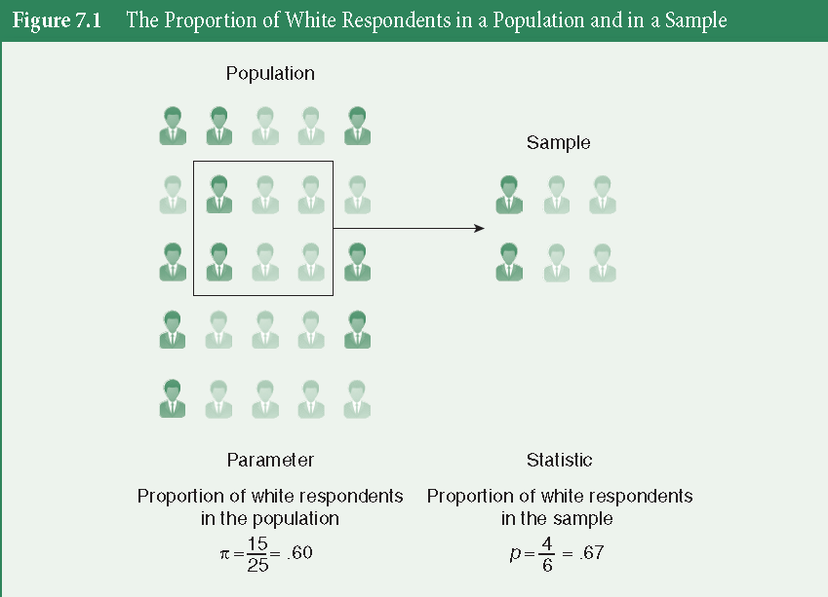
Sampling: Parameter and Statistic

Slide 7
Probability Sampling
To make statistical inferences about a population from a sample, our sample must be selected using the statistical logic of probability
Such methods provide a “probability” that a given case will be included in our sample
Enables us to specify, for each case in the population, the probability of its inclusion in the sample

Slide 8
Probability Sampling
Ensures that our sample is representative of our population
Allows us to conduct statistical analyses on our sample
Tells us how close or how far our sample statistics are to the population parameters

Slide 9
Simple Random Sampling
A sample design where:
Every member of the population has an equal chance of being chosen and
Every combination of N members has an equal chance of being chosen
You need the sampling frame
A list of all the cases in the population, then use it to randomly select a number of cases from it

Slide 10
Example: Simple Random Sampling
Assume you have the “mtcars” data set (population and sampling frame)
You can select a simple random sample using a random number generator
use the rand() function in Excel to randomly assign a number to each case, sort by that number, and select the amount of cases you want in your sample
Or use the sample function in R

Slide 11
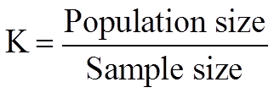
Systematic Random Sampling
A method of sampling in which every K^{th} member in the total population is chosen for inclusion in the sample
The first member of the sample is selected at random, then every K^{th} member is chosen

Slide 12
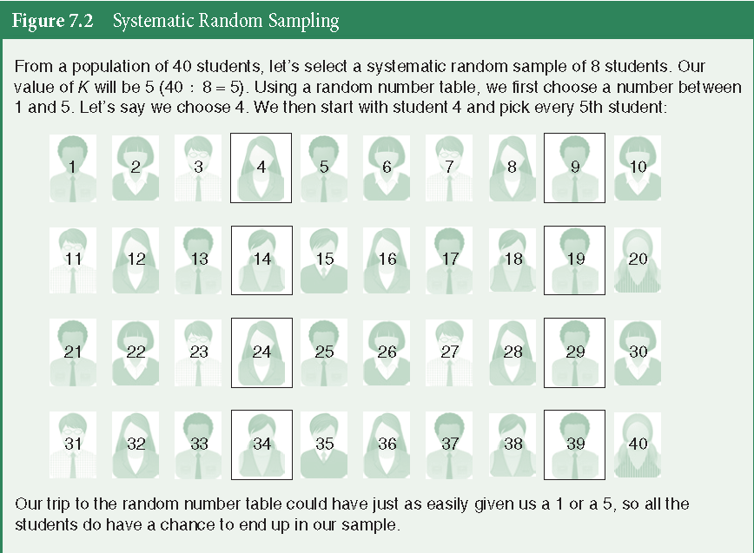
Systematic Random Sampling

Slide 13
Stratified Random Sampling
A method of sampling obtained by
Dividing the population into subgroups (strata) based on one or more variables central to our analysis (e.g. gender, race, class)
Drawing a simple random sample from each of the subgroups

Slide 14
Stratified Random Sampling
Proportionate Stratified Sample
The size of the sample selected from each subgroup is proportional to the size of that subgroup in the entire population

Slide 15
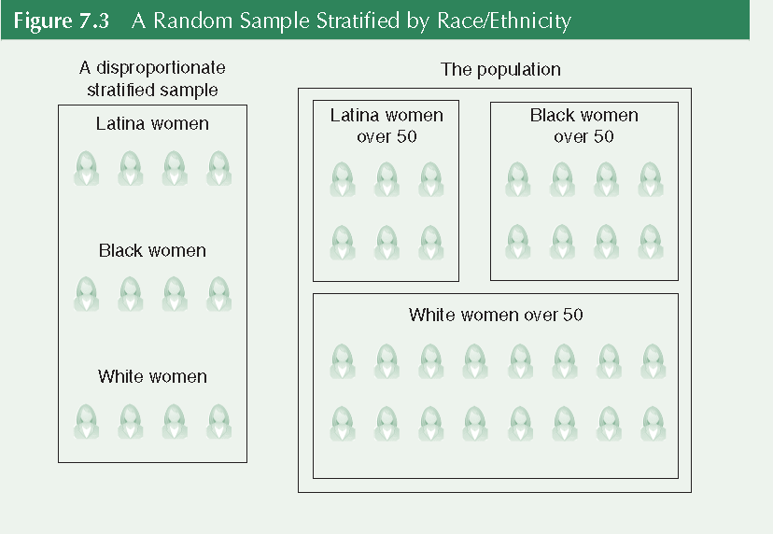
Stratified Random Sampling
Disproportionate Stratified Sample

Slide 16
Sampling Distributions
Sampling Distribution
A theoretical distribution of all possible sample values for the statistic we are interested in
If we were to draw all possible random samples of the same size from our population of interest, we would obtain an approximation of the sampling distribution
Helps estimate the likelihood of our sample statistics and enables us to generalize from the sample to the population

Slide 17
Sampling Distributions
Sampling Error
The discrepancy between a sample estimate of a population parameter and the real population parameter

Slide 18
Example: Sampling Distributions
Population of 20 cases
Mean income = $22,766
Standard Deviation = $14,687
Sample of 3 cases
Mean = $20,817
Sampling Error
μy – Y = 22,766-20,817 = 1,949
_

Slide 19
Sampling Distributions
Sampling Distribution of the Mean
A theoretical probability distribution of sample means that would be obtained by drawing from the population all possible samples of the same size

Slide 20
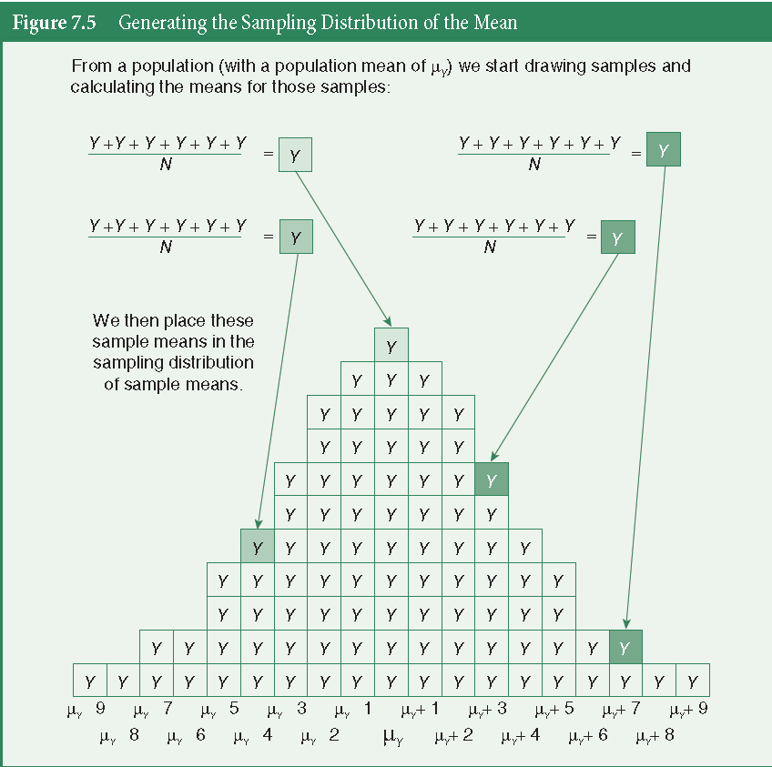
Sampling Distributions

Slide 21

Sampling Distributions
Standard Error of the Mean
The standard deviation of the sampling distribution of the mean
It describes how much dispersion there is in the sampling distribution of the mean
How much variability there is in the value of the mean from sample to sample
σ_{y =}
_

Slide 22
The Central Limit Theorem
If all possible random samples of size N are drawn from a population with mean μ_{y} and a standard deviation σ_{y}, then as N becomes larger, the sampling distribution of sample means becomes approximately normal
The sampling distribution will be less skewed than the population distribution
As N increases, the sampling distribution becomes more compact (since the standard deviation decreases)

Slide 23
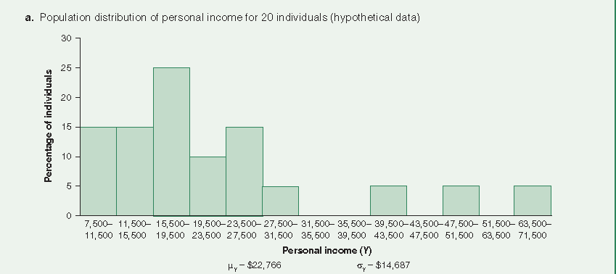
Example: Three Income Distributions

Slide 24
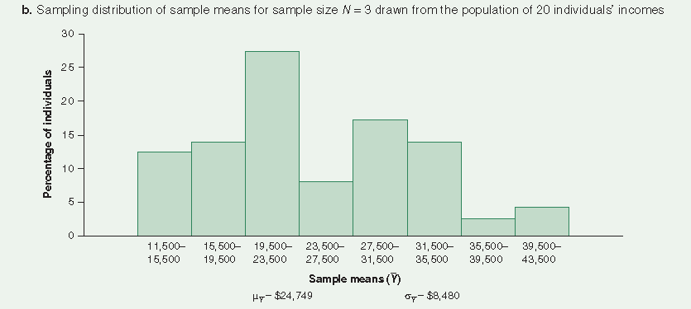
Example: Three Income Distributions

Slide 25
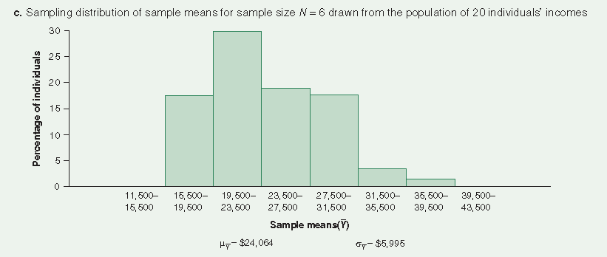
Example: Three Income Distributions

Slide 26
Key Terms
Central Limit Theorem
Disproportionate Stratified Sample
Parameter
Population
Probability Sampling
Proportionate Stratified Sample
Sample
Sampling Distribution

Slide 27
Key Terms
Sampling Distribution of the Mean
Sampling Error
Simple Random Sample
Standard Error of the Mean
Statistic
Stratified Random Sample
Systematic Random Sampling

